Slide 1



A preprint server for the Earth and Planetary Sciences
Christopher Jackson and the EarthArXiv Community
Why preprints?
About
EarthArXiv
FAQ

Slide 2
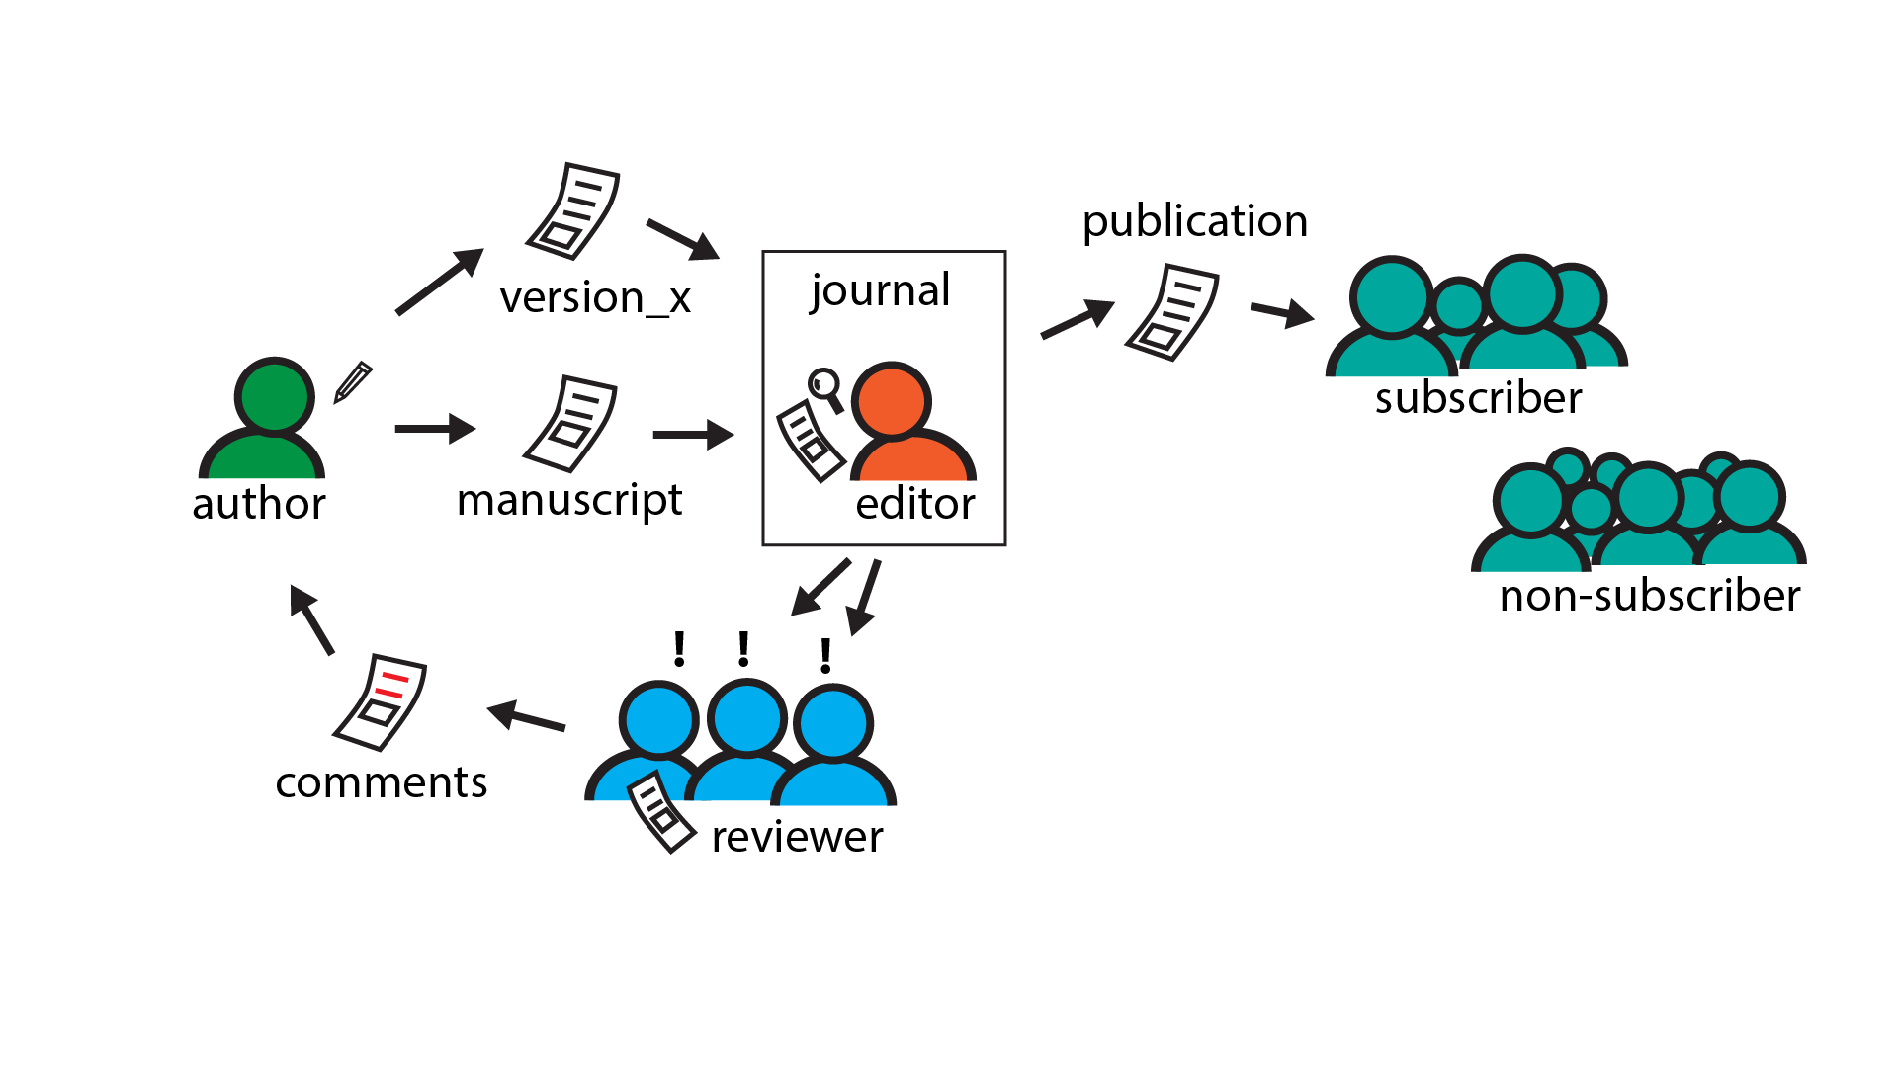
publication pathway(s)

Slide 3
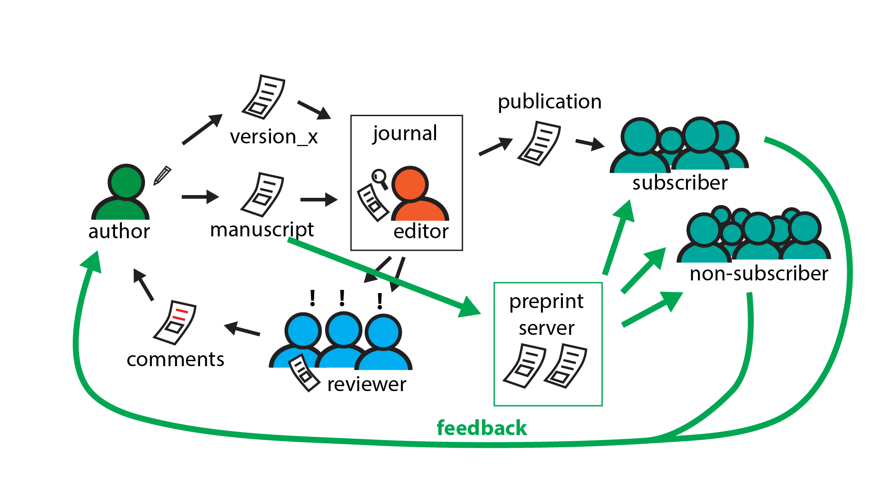
publication pathway(s)

Slide 4
You should consider submitting a preprint if:
You are seeking to communicate your scientific findings without delay
You want everyone to have access to your work
You want feedback on your work from the community
You want to publish larger datasets

Slide 5
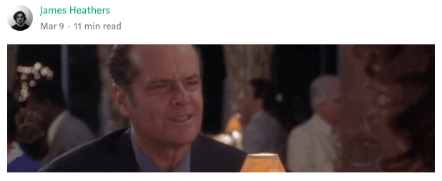
You should consider submitting a preprint if:
You are seeking to communicate your scientific findings without delay
You want everyone to have access to your work
You want feedback on your work from the community
You want to publish larger datasets
https://medium.com/@jamesheathers/why-i-love-pre-prints-9d727eeb22b8
Publishing pre-prints sends a message I want to send.
They say I am willing to talk. They say I want to participate in open culture. Please read my stuff.
Back to menu

Slide 6

Preprints are:
free to submit
fast to publish
open access
established in many natural sciences
EarthArXiv.org
A preprint server for Earth and Planetary sciences

Slide 7



EarthArXiv.org
A preprint server for Earth and Planetary Sciences
online since October 2017
>300 contributions
ca. 1600 downloads monthly
community driven & independent
supported by
Back to menu

Slide 8

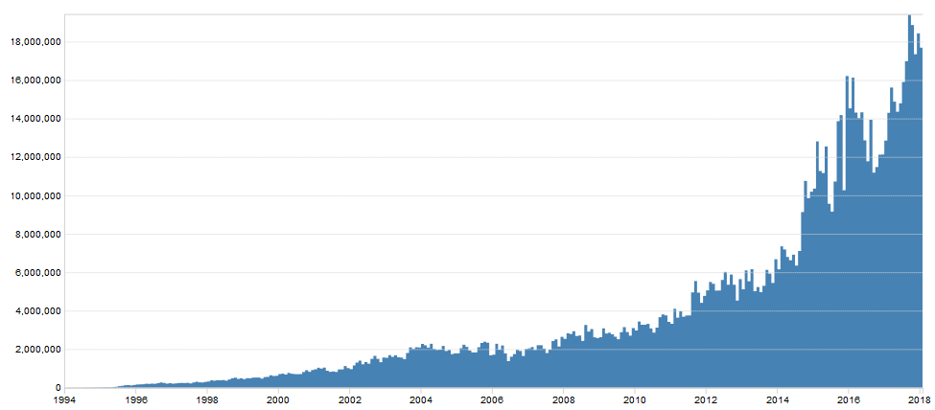
Preprint history –
arXiv.org started in 1991 by Paul Ginsparg for rapid communication of science (e.g. mathematics, physics, astronomy, computer science, quantitative biology, statistics, and quantitative finance)
today: >1.3 million total submissions;
>1 billion total downloads;
>100,000 publications per year;
c. 18 million downloads per month
18,000,000
10,000,000
Monthly downloads
Year
Back to menu

Slide 9

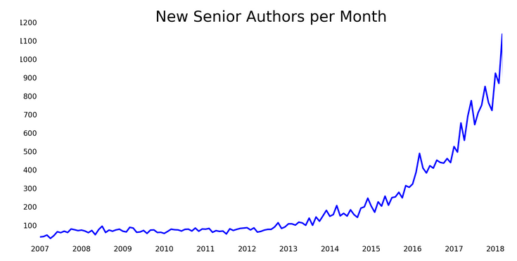
Preprint history –
A preprint repository for the biological sciences, co-founded by John Inglis and Richard Sever in November 2013
Hosted by the Cold Spring Harbor Laboratory (CSHL).
Papers hosted on bioRxiv are not peer-reviewed, but undergo basic screening and checked against plagiarism.
Readers may offer comments on the preprint.
Receives support from both the CSHL, the Lourie Foundation, the Chan Zuckerberg Initiative
today: >XXX total submissions; >X total downloads; >XX publications per year; c. XX million downloads per month
New senior authors
per month
Year
Back to menu

Slide 10
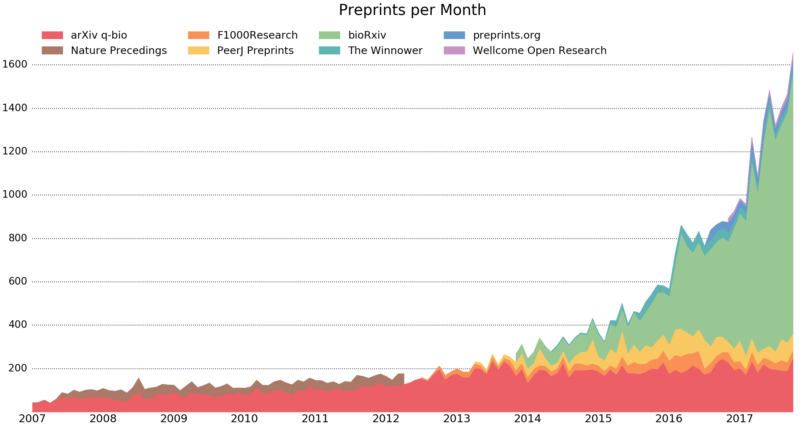
Preprint history
Monthly downloads
Preprints per month
Year
Preprints are not new!
Preprints based on various infrastructure models (e.g. journal vs. community led)
Back to menu

Slide 11
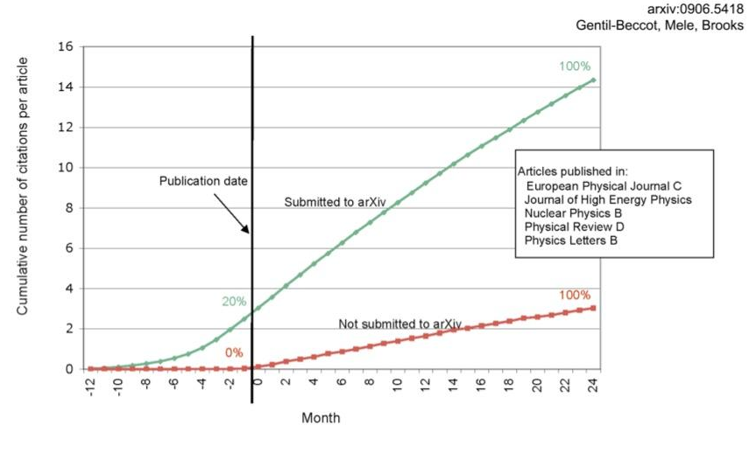
Impact –
There is evidence that submissions to preprint servers such as arXiv.org attract citations earlier and have a higher cumulative number of citations
Back to menu

Slide 12
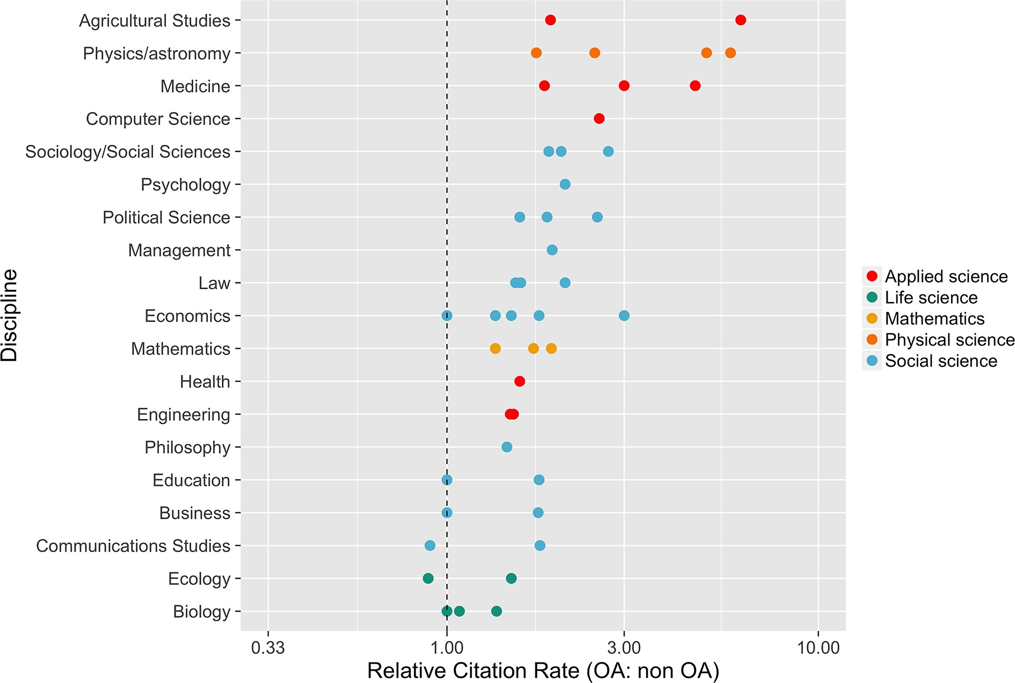
Impact – Open Access
McKiernan et al. (2016)
Back to menu

Slide 13

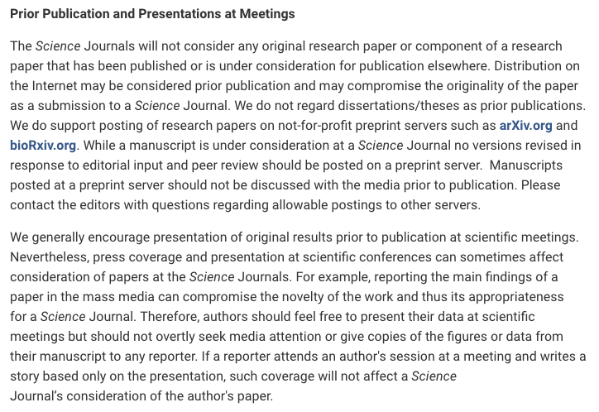
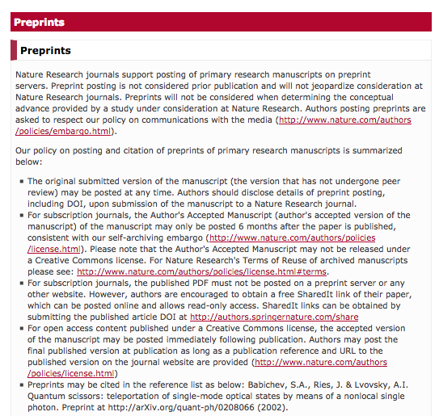


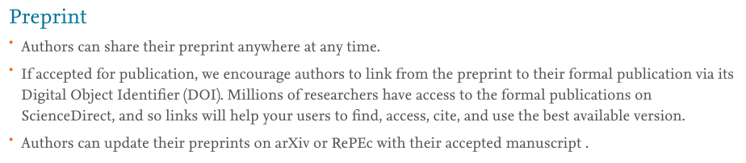
Support - preprints
http://www.sciencemag.org/authors/science-journals-editorial-policies (Friday 6th April 2018)
https://www.nature.com/authors/policies/preprints.html?foxtrotcallback=true (Friday 6th April 2018)
https://www.elsevier.com/about/our-business/policies/sharing (Friday 6th April 2018)
Back to menu

Slide 14
You should consider submitting a preprint if:
You are seeking to communicate your scientific findings without delay
You want everyone to have access to your work
You want feedback on your work from the community
You want to publish larger datasets
Back to menu

Slide 15
You should consider submitting a preprint if:
You are seeking to communicate your scientific findings without delay
You want everyone to have access to your work
You want feedback on your work from the community
You want to publish larger datasets
https://medium.com/@jamesheathers/why-i-love-pre-prints-9d727eeb22b8
Publishing pre-prints sends a message I want to send.
They say I am willing to talk. They say I want to participate in open culture. Please read my stuff.
Back to menu

Slide 16
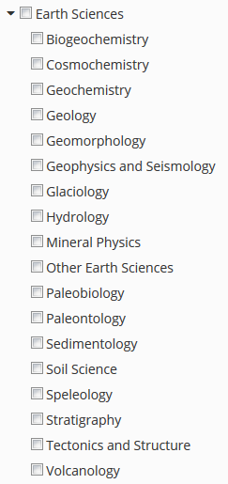
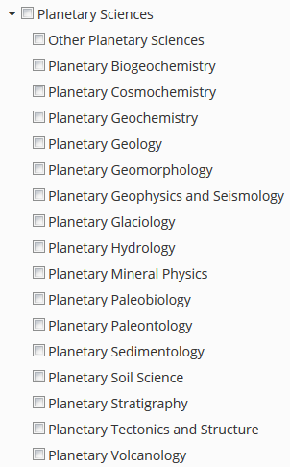
Earth Science
categories
Planetary Science
categories
Back to menu

Slide 17
EarthArXiv.org
Organisation
community driven – everybody can get involved
advisory board
Sara Bosshart, International Water Association, UK
Alodie Bubeck, University of Leicester, UK
Allison Enright, Rutgers - Newark, USA
Jamie Farquharson, Université de Strasbourg, France
Alfonso Fernandez, Universidad de Concepcion, Chile
Stéphane Girardclos, University of Geneva, Switzerland
Friedrich Hawemann, ETH Zurich, Switzerland
Rebecca Williams, University of Hull, UK
Daniel Ibarra, Stanford University, USA
Chris Jackson, Imperial College London, UK
Sabine Lengger, University of Plymouth, UK
Tom Narock, Notre Dame of Maryland University, USA
Andelo Pio Rossi, Jacobs University Bremen, Germany
Divyesh Varade, Indian Institute of Technology Kanpur, India
Chris Waigl, University of Alaska Fairbanks, USA
Back to menu

Slide 18



@eartharxiv
Join us, follow us!
Be part of an OPEN community!
Back to menu

Slide 19
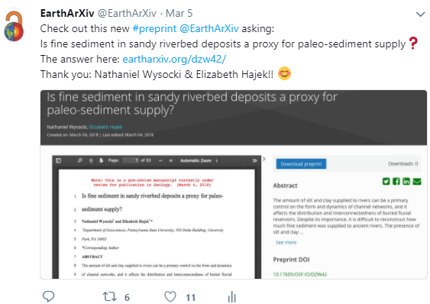
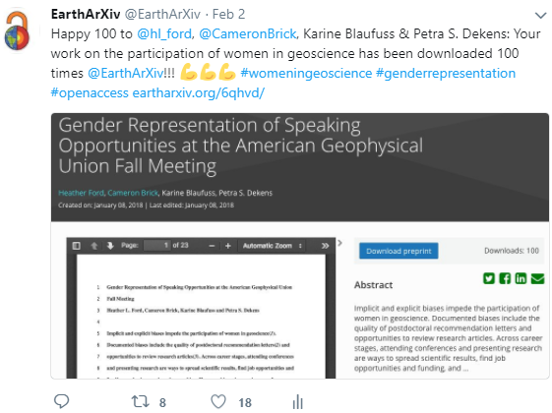
@eartharxiv
Join us, follow us!
Make your work VISIBLE!
Back to menu

Slide 20
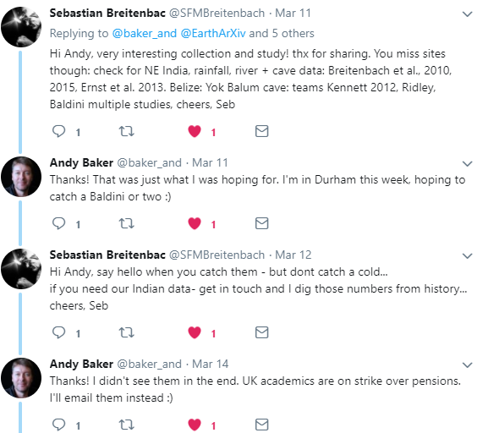
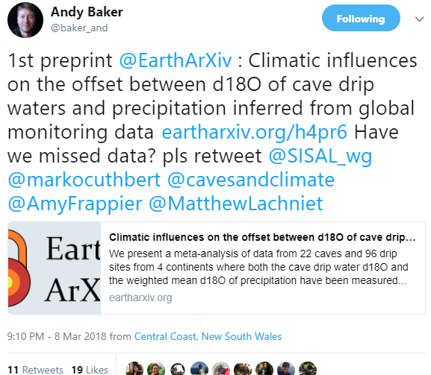
@eartharxiv
Join us, follow us!
Make your work BETTER!
Back to menu

Slide 21



EarthArXiv.org
let’s talk about…
Get in touch!
@eartharxiv
moderation policy
@eartharxiv
www.eartharxiv.org
tnarock@ndm.edu
c.jackson@imperial.ac.uk
Back to menu

Slide 22
What you can do?
Promote preprints to your discipline or community
Post preprints to speed up the pace of communicating your research: osf.io/preprints
Start a preprint for your community or discipline: https://cos.io/our-products/osf-preprints/
Contact us:
matt.spitzer@cos.io
cos.io/contact

Slide 23

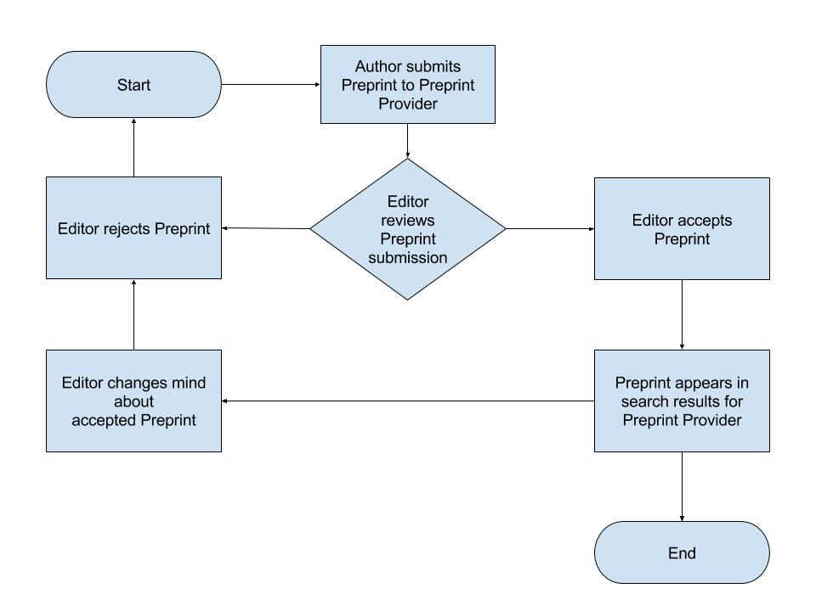
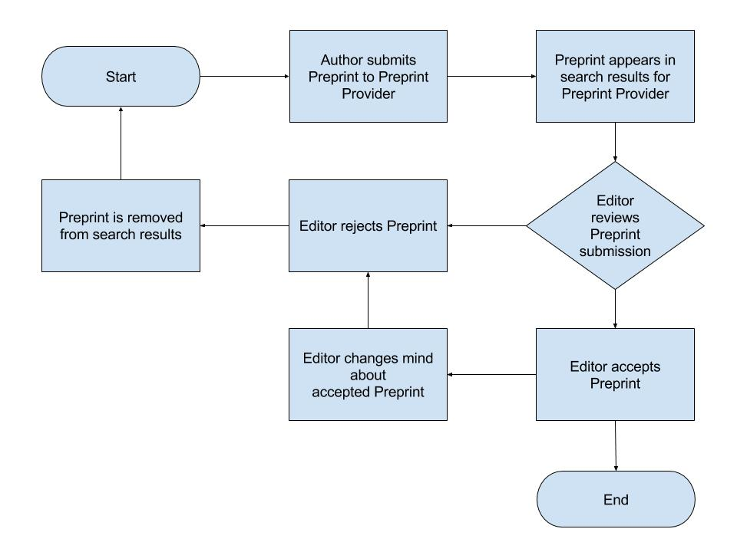
EarthArXiv.org
moderation policy – 2 potential approaches
Pre-Moderation
Post-Moderation

Slide 24
EarthArXiv.org
moderation policy
What does EarthArXiv accept?
Research articles
Review papers
Case studies
Technical notes (e.g. new instrumentation or analysis methods)
Confirmatory studies
So-called ‘null’ results (i.e. results that not supporting a hypothesis)
Dataset description papers
What does EarthArXiv not accept?
Papers reading as a personal attack, airing of grievances, or insulting to a group/class of people. Racist and derogatory language will not be tolerated
Commentaries and opinion pieces
Posters (cf. ESSOAr)
Theses and course projects (see www.thesiscommons.org)
Software articles
back to previous section

Slide 25
EarthArXiv.org
moderation policy
Publication and hosting of your paper
Upon moderation, EarthArXiv agrees to publish your paper by assigning a DOI
EarthArXiv is not a journal and does not evaluate the scientific quality of a paper. Once a paper passes moderation and is published, it persists on the system indefinitely. N.B. EarthArXiv reserves the right to remove papers after publication if fraud or plagiarism is identified (see right).
EarthArXiv will provide free online hosting of your paper as long as it is operational
Fraud and Plagiarism
EarthArXiv takes fraud and plagiarism very seriously. Detection of fraud and plagiarism involve manual moderation, automated algorithms, and community feedback. Any claim of fraud or plagiarism will be granted a review by the Advisory Board. Should the Board deem fraud or plagiarism to have occurred, the paper will be immediately removed from EarthArXiv
back to previous section

Slide 26

EarthArXiv.org
Commenting policy
http://www.industrialpersonnel.co.uk/can-get-better-receiving-feedback/
To enable peer feedback, collaboration and transparency in scientific research practices, Hypothesis and the Center for Open Science (COS) are announcing a new partnership to bring open annotation to Open Science Framework (OSF) Preprints. The partnership enables researchers to engage with each other, discuss research and share additional information as part of the regular research workflow
back to previous section

Slide 27
EarthArXiv is not the only preprint server for earth sciences.
ESSOAR is developed by AGU with generous support by Wiley
ESSOAR hosts preprints and conference posters.
back to previous section

Slide 28
COS is a non-profit technology organization based in Charlottesville, Virginia with a mission to "increase the openness, integrity, and reproducibility of scientific research.”.
It was founded in January 2013 by Brian Nosek and Jeffrey Spies, funded mainly by the Laura and John Arnold Foundation and others, after implementation and use of the Open Science Framework
back to previous section

Slide 29
OSF Preprints and the OSF supporting it are public goods infrastructure with open-source code at the COS GitHub repo
10,000+ preprints currently hosted directly on the OSF across 19, co-searchable services
Powered by SHARE (share.osf.io), OSF Preprints aggregates search across local and external preprint services
Currently >2M preprint records available
back to previous section

Slide 30
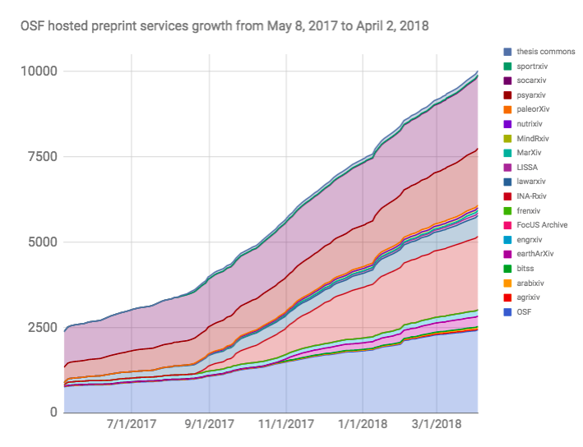
OSF Preprints and the OSF supporting it are public goods infrastructure with open-source code at the COS GitHub repo
10,000+ preprints currently hosted directly on the OSF across 19, co-searchable services
Powered by SHARE (share.osf.io), OSF Preprints aggregates search across local and external preprint services
Currently >2M preprint records available
Submissions hosted
back to previous section
Time

Slide 31
Connecting the research workflow and archiving activities, changes, outputs with tools to facilitate collaboration, sharing, and ease of access
back to previous section

Slide 32
FAQ
Answer
Will someone steal my work in my preprint?
Click on a Question!
Will preprints lead to large volumes of low-quality material on EarthArXiv?
Can EarthArXiv only host preprints?
Will publishing a preprint mean I can’t publish in a journal?
How do I link data to my preprint?
Does my preprint get a DOI and how might this impact citation count?
Back to menu

Slide 33
FAQ
Answer
Will someone steal my work in my preprint?
Based on experiences at very established (e.g. ArXiv) and newer, but rapidly growing preprint services (e.g. BioArXix, SocArXiv), there is no evidence that preprints lead to being scooped.
If someone is prepared to steal ideas from a timestamped/’DOI’d’ preprint, they would likely do the same from material in a journal or from a conference presentation.
The reputational damage associated with intellectual theft is significant and long-lasting, thus the latter is very rare.
Will preprints lead to large volumes of low-quality material on EarthArXiv?
Can EarthArXiv only host preprints?
Will publishing a preprint mean I can’t publish in a journal?
How do I link data to my preprint?
Does my preprint get a DOI and how might this impact citation count?
Back to menu

Slide 34
FAQ
Answer
Will someone steal my work in my preprint?
Anecdotal evidence suggests this behavior has not emerged in the physics community via use of ArXiv
Because preprinting requires public disclosure, authors are wary of developing a bad reputation; if the work is poor, it will likely be ignored by the rest of the community...with the same applying to material published in a journal
RSS feeds allow sorting of material posted to EarthArXiv; cf. Google Scholar
Initial evidence and download statistics suggests EarthArXiv is hosting high-quality, desirable material...
Will preprints lead to large volumes of low-quality material on EarthArXiv?
Can EarthArXiv only host preprints?
Will publishing a preprint mean I can’t publish in a journal?
How do I link data to my preprint?
Does my preprint get a DOI and how might this impact citation count?
Back to menu

Slide 35
FAQ
Answer
Will someone steal my work in my preprint?
No. EarthArXiv is also a repository for postprints (i.e. material already published in a journal)
Depending on journal policy, we can host the Author Accepted Manuscript (i.e. accepted version of paper, but before publisher typesetting) (AAMs) or the Version of Record (VoR) (i.e. published version of paper, after publisher typsetting)
Check your journal’s policy on SHERPARoMEO
EarthArXiv can also host datasets, textbooks, book chapters, etc. Please contact us if you have any queries!
Will preprints lead to large volumes of low-quality material on EarthArXiv?
Can EarthArXiv only host preprints?
Will publishing a preprint mean I can’t publish in a journal?
How do I link data to my preprint?
Does my preprint get a DOI and how might this impact citation count?
Back to menu

Slide 36
FAQ
Answer
Will someone steal my work in my preprint?
In most cases, the answer is ‘no’; because preprinting has been ongoing in other disciplines for, in some cases, a few decades, many publishers have preprint-friendly policies already in place for their journals
Check your journal’s policy on SHERPARoMEO
Will preprints lead to large volumes of low-quality material on EarthArXiv?
Can EarthArXiv only host preprints?
Will publishing a preprint mean I can’t publish in a journal?
How do I link data to my preprint?
Does my preprint get a DOI and how might this impact citation count?
Back to menu

Slide 37
FAQ
Answer
Will someone steal my work in my preprint?
Open Science Framework’s infrastructure allows unlimited disk space for uploading of publication-related data (N.B. there is a per file upload limit of 5GB)
More commonly, data, and especially large volumes of data, are stored on external sites (e.g. Dropbox, GitHub, figshare, Google Drive) and linked back to the related preprint/postprint
Will preprints lead to large volumes of low-quality material on EarthArXiv?
Can EarthArXiv only host preprints?
Will publishing a preprint mean I can’t publish in a journal?
How do I link data to my preprint?
Does my preprint get a DOI and how might this impact citation count?
Back to menu

Slide 38
FAQ
Answer
Will someone steal my work in my preprint?
Preprints minted with a DOI upon submission
The EarthArXiv-assigned DOI will persist even if the research is eventually published in a journal
Preprints can collect citations, which count towards H-Index
Citations could, in theory, be split between preprint and VoR; the solution to this is to simply aggregate the citations
Note that the preprint can direct readers to the published version (Version of Record or ‘VoR’); evidence indicates researchers typically cite the latter and not the former
Will preprints lead to large volumes of low-quality material on EarthArXiv?
Can EarthArXiv only host preprints?
Will publishing a preprint mean I can’t publish in a journal?
How do I link data to my preprint?
Does my preprint get a DOI and how might this impact citation count?
Back to menu

